Slide 1
Gambia’s First Islamic Finance and Shariah Consulting Firm
Circular Economy and Blended Islamic Finance: A catalytic for Rice Value Chain Transformation Programme (RVCP) and Sustainable Development Goals (SDGs) in The Gambia.
The 8th Africa Islamic Finance Conference
March 23, 2022
Fatou Badjie (UTG) and Karamo Sawaneh (CBG)
email@gmail.com

Slide 2
Headings here
Presentations here

Slide 3
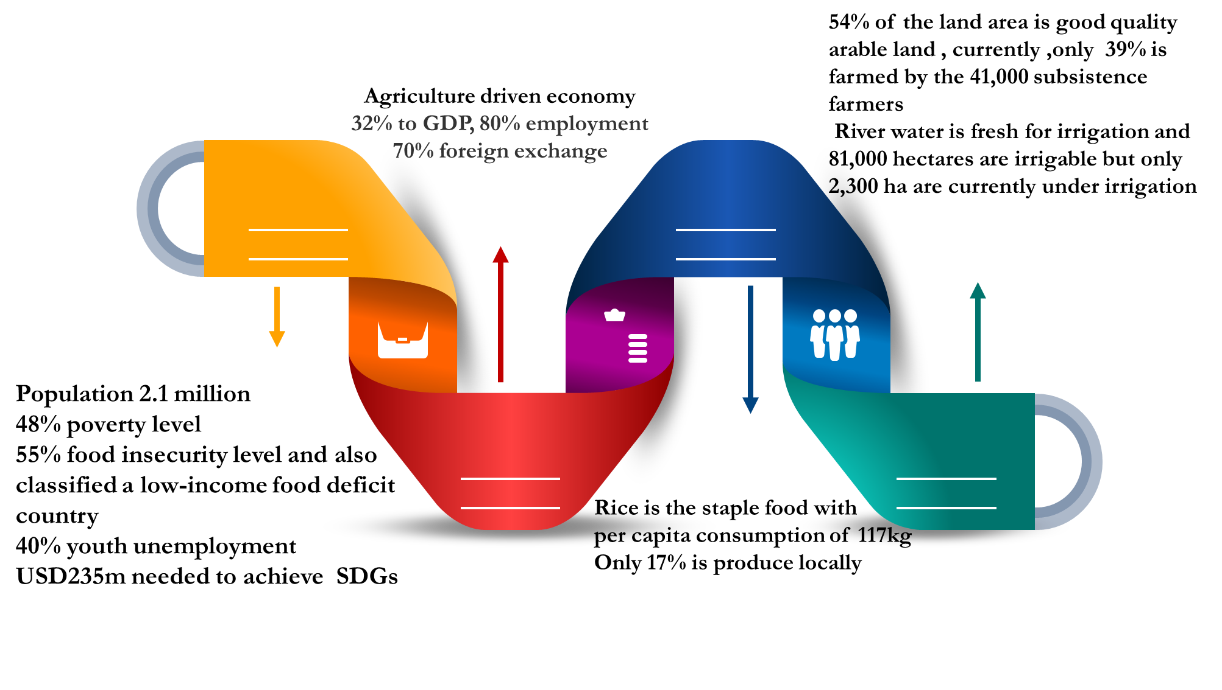
INNTRODUCTIONN

Slide 4
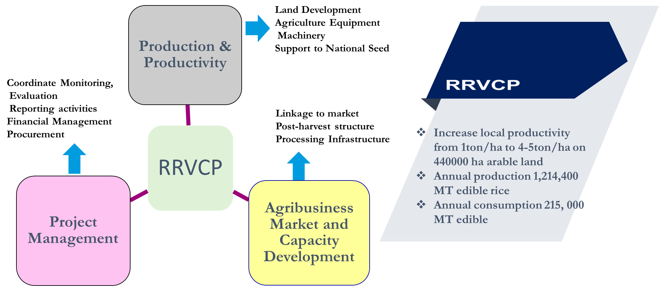
Regional Rice Value Chain Program

Slide 5
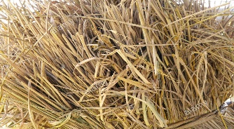
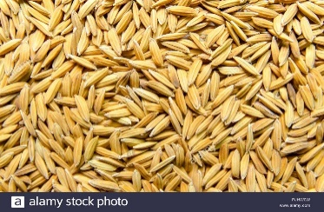
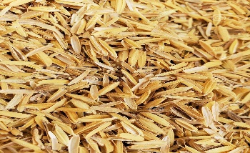
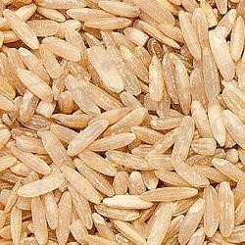
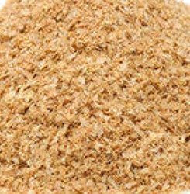
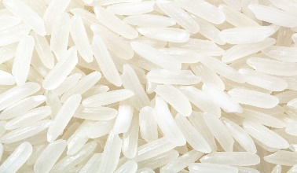
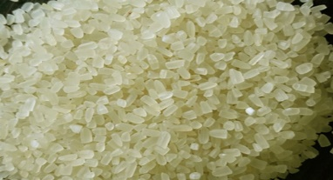
RICE BY - PPRODUCT
Rice straw (1.35 t)
Harvest
Paddy rice (1 t)
Shelling
Rice husk (0.2 t)
Rice by-products
Brown rice
Rice bran (0.1 t)
Milling
Milled rice
Sorting
Broken rice (0.14 t)
Source:(Moraes et al., 2014)

Slide 6
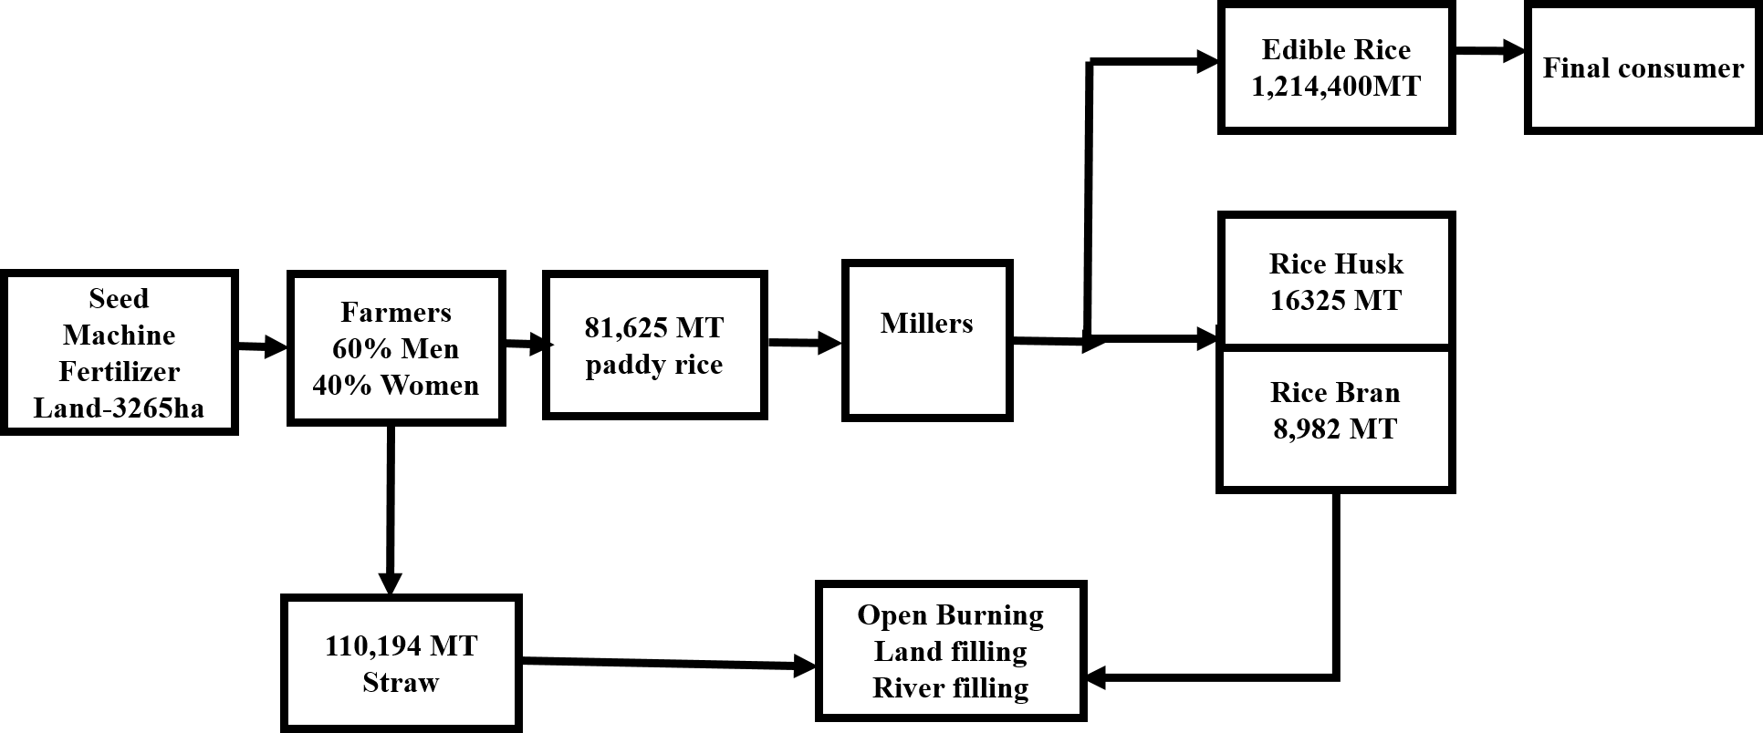
Regional Rice Value chain Program in Linear Economy

Slide 7
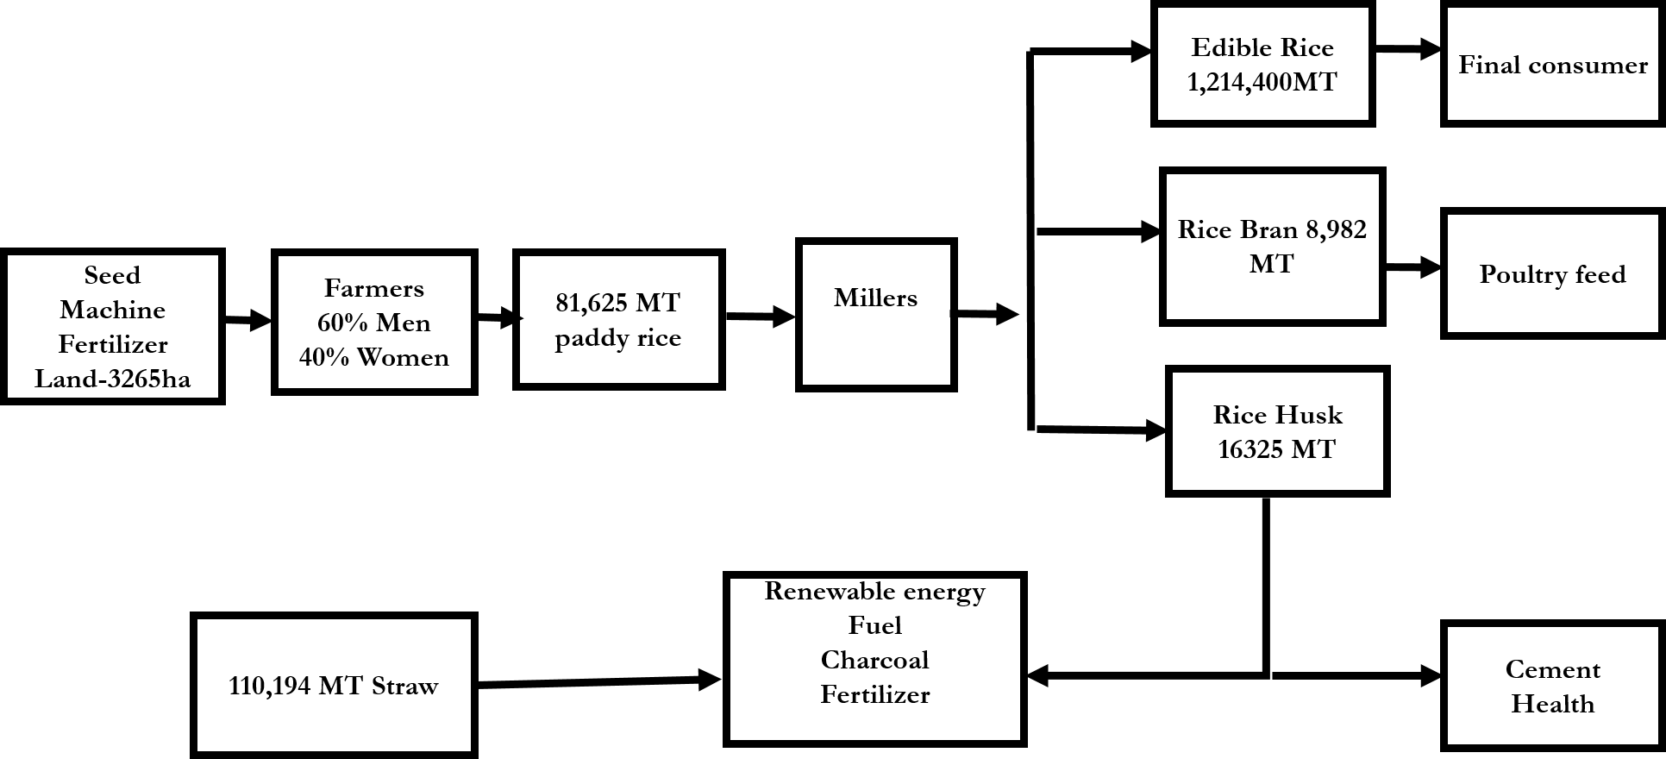
Regional Rice Value chain Program in Circular Economy

Slide 8
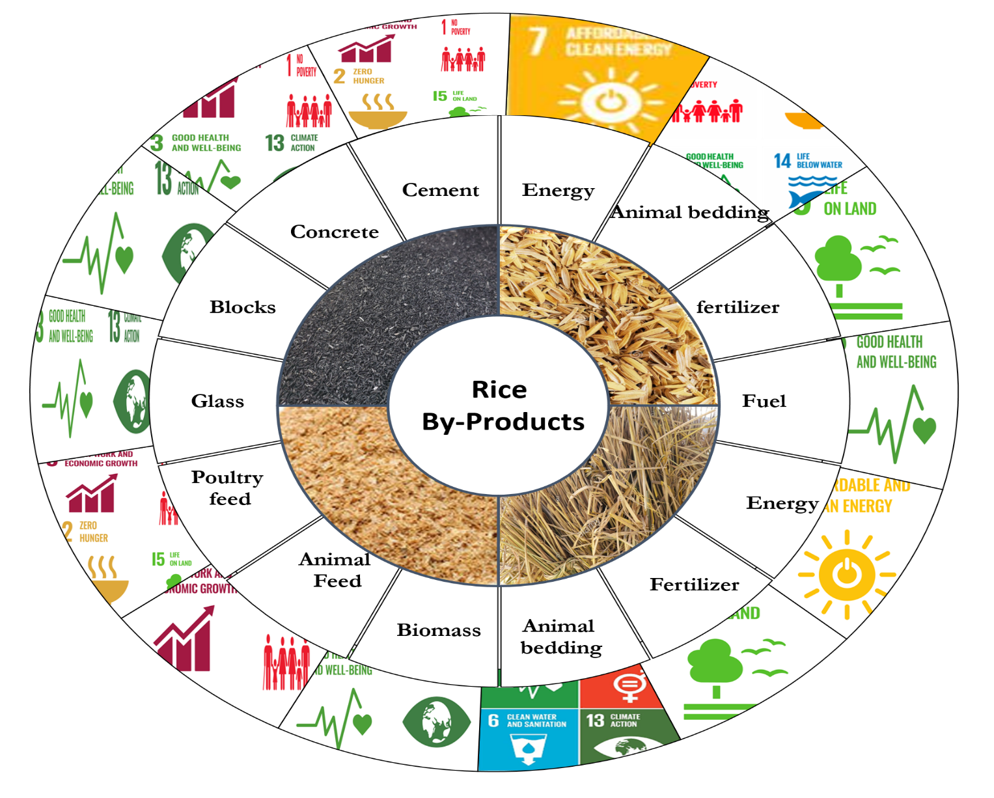
Achieving The SDGs Through Rice by-products

Slide 9
The Gambia and Self-food sufficiency
RIDEP (Rice Irrigation Development Project)
SSWC (Small Scale Water Control Project)
Agriculture and Natural Resource Policy
Gambian National Agricultural Investment Plan (GNAIP)
1991
1998
2009-2015
2011-2015
1997
2010
Agriculture and Natural Resource Policy
LADEP (Lowland Agricultural Development Project )
Vision 2020
National Agricultural Development-Horizon

Slide 10
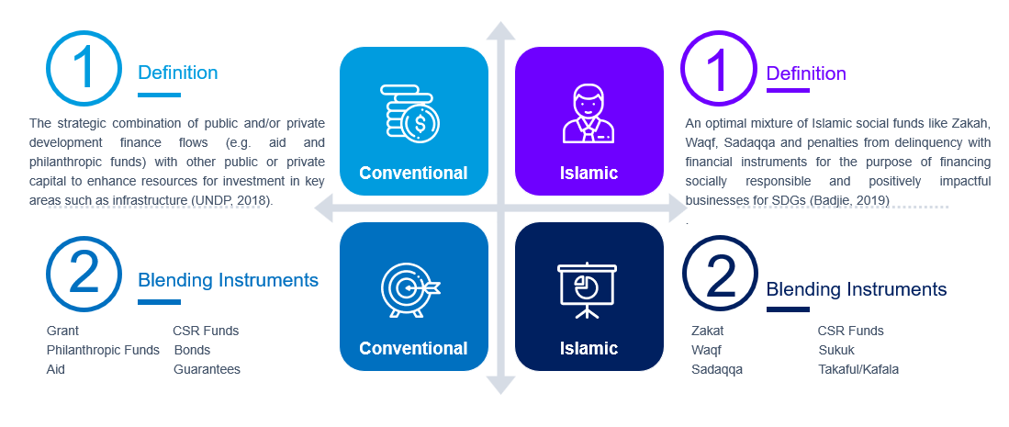
Islamic Blended Finance

Slide 11
Why Islamic Blended Finance?
Win-Win Rationale
Overcome market barriers
Adjust risk-return profile
Replication of similar projects with less/without aid
Mobilizes resources from private sector
Increase Capital flows into investment that deliver development outcome
Enhances impact by augmenting available resource and increase skill, knowledge
Increases the risk adjusted returns for private investment

Slide 12
Blending Instruments: Waqf
Details | Data |  | Projected Cash Contribution per Week | Projected Cash Contribution per Month | Projected Cash Contribution per Year
Contribution Rate (D/Per Week) | 5 |  | 5.706 | 22.825 | 296.724
Collection Error Rate (%) | 0.25 |  | 1.427 | 5.706 | 74.181
Net Collection GMD' millions |  |  | 4.280 | 17.119 | 222.543
Net Collection USD' millions |  |  | 0.086 | 0.342 | 4.451

Slide 13
Blending Instruments: ZAKAT
Estimate of Zakat Potential for The Gambia from 2002 to 2021
Z1
An increased from about 1.1 per cent of GDP in 2004 to almost 1.7 per cent in 2018
Z2
An increase from nearly 2.4 per cent of GDP in 2004 to above 3.7 per cent in 2018
Z3
An increase from 2.7 per cent of GDP in 2004 to almost 4.2 per cent in 2018

Slide 14
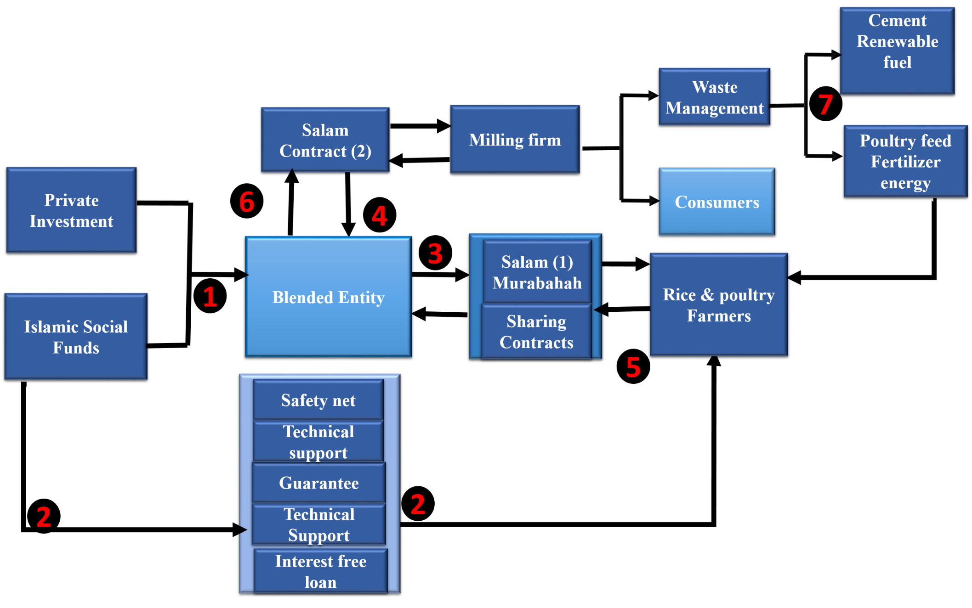
Proposed Blended Salam Model

Slide 15
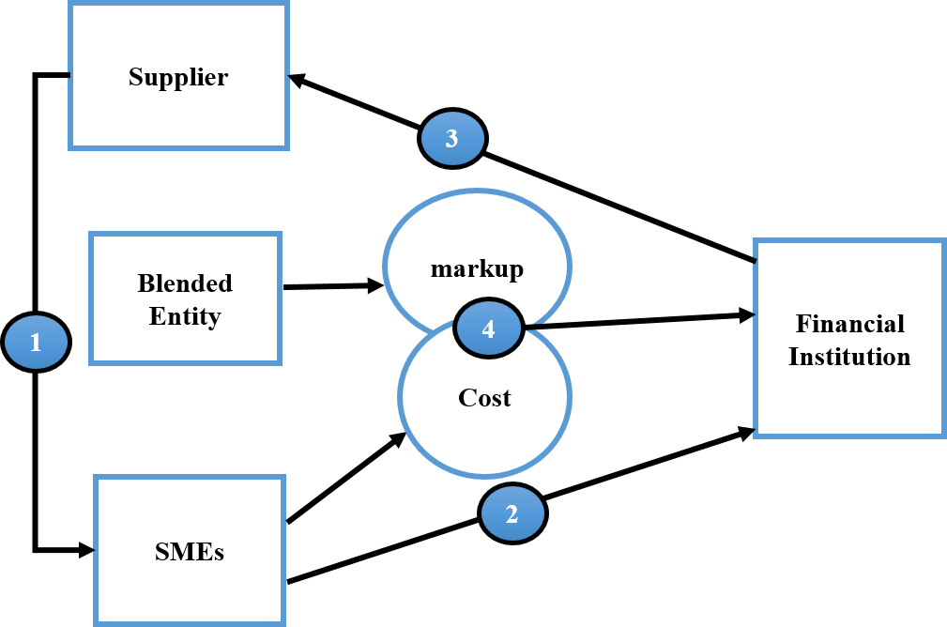
Proposed Blended Murabahah Model for RRVCP

Slide 16
Proposed Blended Murabahah Model for RRVCP
RRVCP may consider adding two more components
waste management/circular and Islamic Blended finance
In order to advance the SDGs
Ensure self-sustainability of RRVCP
Create employment for The Gambian youths
Most importantly, protect the environment

